Slide 1



SLIDE
Phone-hunter
API
PROGRAMMING HERO

Slide 2
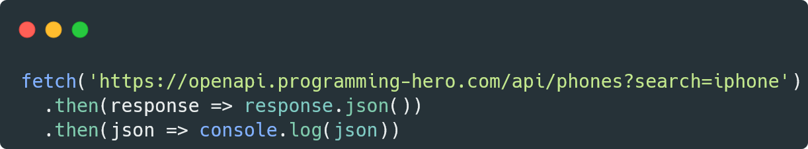
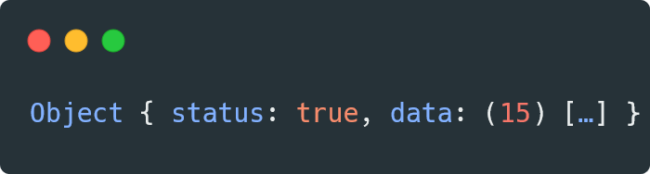

PAGE 01
Try this

Slide 3
PAGE 02
What is it
Phone-hunter API is being created by programming hero so that you can practice API related tasks and get some fake data.

Slide 4
PAGE 03
Purpose
Getting all of the phone information by searching any phone name. For 4 types of phone you will get information: samsung, iphone, huawei, oppo.
Getting the detail information for a single phone. For example: apple-iphone-13-pro-max

Slide 5
PAGE 03
Phone search
URL format:
https://openapi.programming-hero.com/api/phones?search=${searchText}
Example:
https://openapi.programming-hero.com/api/phones?search=iphone

Slide 6
PAGE 03
Single phone detail
URL format:
https://openapi.programming-hero.com/api/phone/${id}
Example:
https://openapi.programming-hero.com/api/phone/apple_iphone_13_pro_max-11089

Slide 7
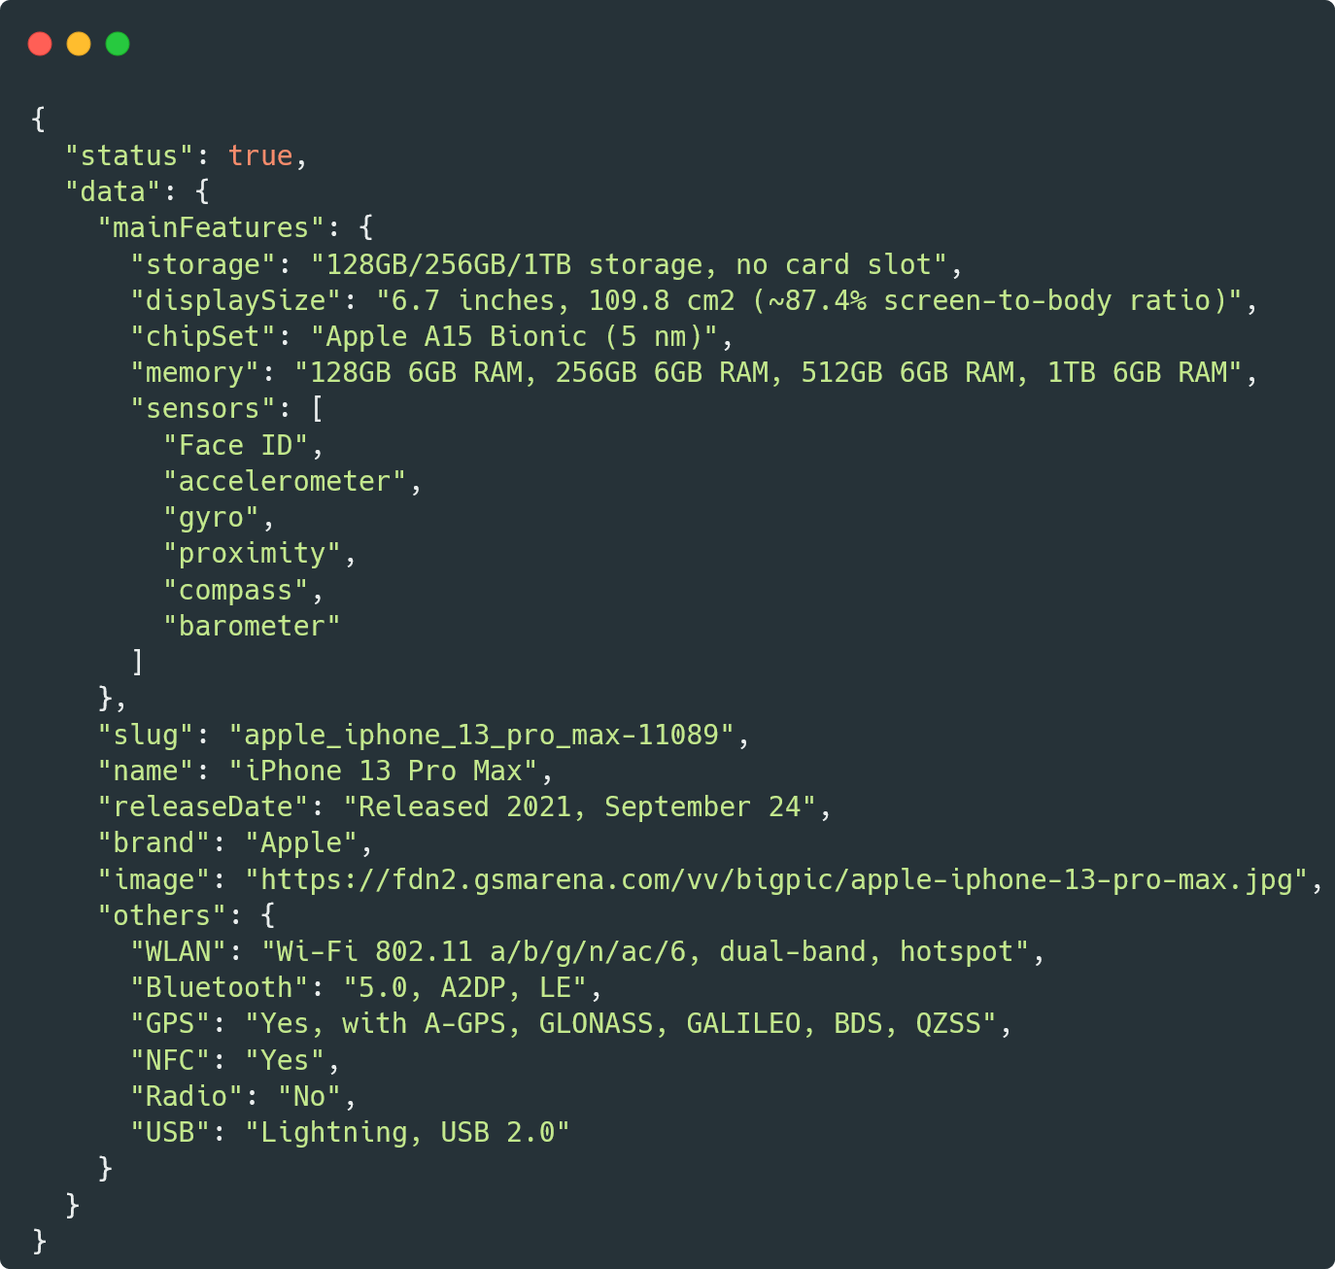
PAGE 03
Search result for
https://openapi.programming-hero.com/api/phone/apple_iphone_13_pro_max-11089
Phone id

Slide 8
PAGE 03
Our objective using the API
Accessing property of nested object
Loading some data using array slice
(example: total output:50, getting 10 data from 50)
Loading rest results after clicking more button
Error handling on search
(example: empty search)
(example: wrong search)
Spinner on loading
Handling missing property using optional chaining
Showing use of ternary operator (optional)
Getting details of a phone using modal on button click

Slide 9
PAGE 03
Sample UI
https://phone-store-gg.netlify.app/
https://phonearene-com.netlify.app/
https://ios-to-to-company.netlify.app/

Slide 10

SLIDE
Let’s Practice
PROGRAMMING HERO

